Slide 1


Health and Wellbeing
Our Vision
Cwmaber Cares and Nurtures
Creates confident, committed collaborators
Warm, welcoming, well-being warriors
Motivated mindful movers
Ambitious active achievers
Be brave, be bold, be you
Enthusiastic, energised, empathetic enterprisers
Resilient, respectful, responsible role-models.

Slide 2
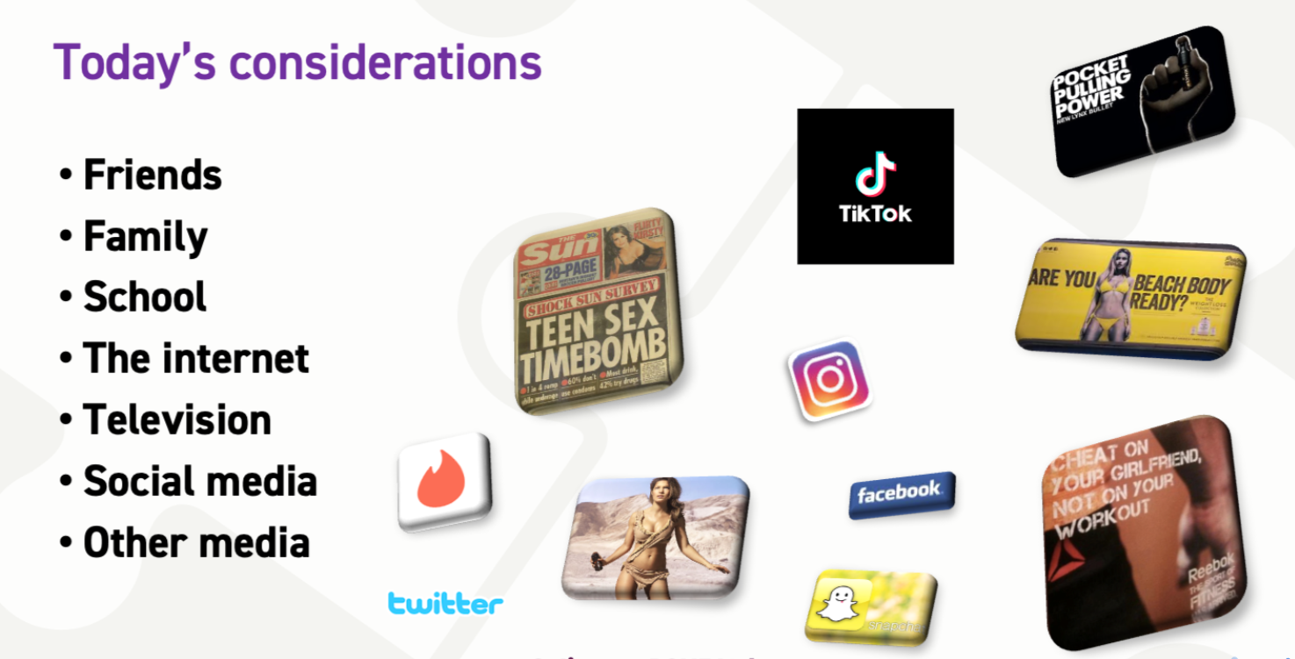
When teaching RSE today we have to be mindful of today’s considerations.

Slide 3
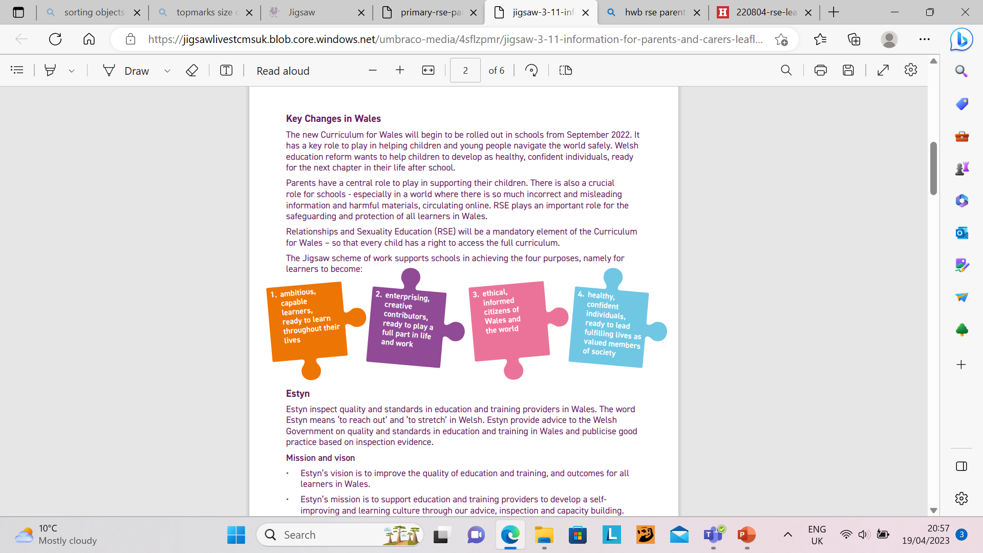

Slide 4
Why is RSE for the learners of Wales so important?
The world around us is evolving rapidly and significantly. As a society we are becoming ever more aware of:
• changing family structures and relationships
• shifting social, cultural and religious norms in relation to sex, gender and sexuality
• advances in technology including the rising influence of social media and increased use of digital communications and devices
• changing laws and rights around relationships, sex, gender and sexuality
Relationships and Sexuality Education - YouTube

Slide 5
2. Explanation of Mandatory Elements
Each of the three strands has a mandatory code for schools to follow . Primary Schools will be expected to cover Phase 1 and 2.
Relationships and Identify:
https://hwb.gov.wales/api/storage/7563a23c-98f6-4147-a8c5-92fe48fa5898/1-relationships-and-identity-strand-mandatory-content.pdf
Sexual Health and Wellbeing:
https://hwb.gov.wales/api/storage/421e40ad-dbc6-4d6c-ba38-7d49433a1019/2-sexual-health-and-well-being-strand-mandatory-content.pdf
Empowerment, Safety and Respect:
https://hwb.gov.wales/api/storage/a25c8a68-6ec7-4e8c-a33d-12e22bca7fea/3-empowerment-safety-and-respect-strand-mandatory-content.pdf
What will primary children be taught? - YouTube

Slide 6

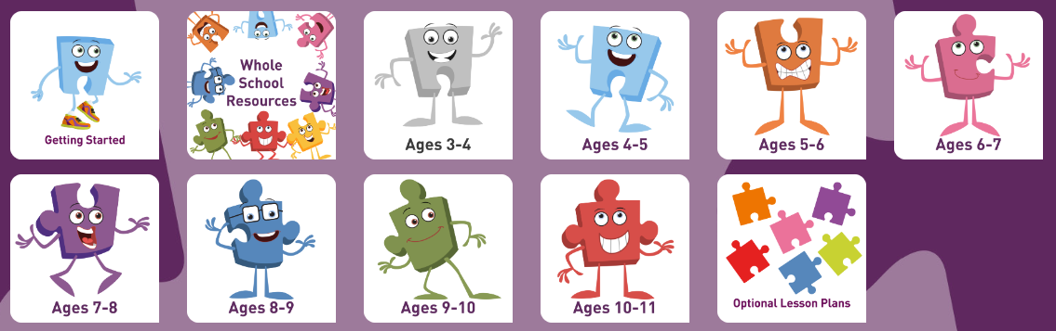
In order to support
our RSE curriculum
we use Jigsaw
Learning.
Jigsaw is the mindful approach to health and well-being is a teaching and learning programme and has a strong focus on emotional and mental health and wellbeing. Jigsaw believes that this work is vital to support children’s development and to underpin their learning capacity, and that it is most effective when parents and carers work in partnership with the school. Jigsaw, like schools and parents, want children to be safe, healthy and happy.
Schools will be respectful of the faith, beliefs and contexts of children’s families, engaging with parents and carers. Children’s safety and wellbeing is paramount and schools must fulfil their statutory duties. The Jigsaw Programme includes lessons on ALL aspects of compulsory Relationships and Sexuality Education, designed in a sensitive, spiral, age-appropriate curriculum. At Jigsaw, we believe this work is an important part of safeguarding children, as knowledge empowers them, helping them to stay safe and cope with puberty understanding why their bodies will change.

Slide 7
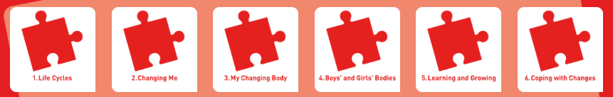
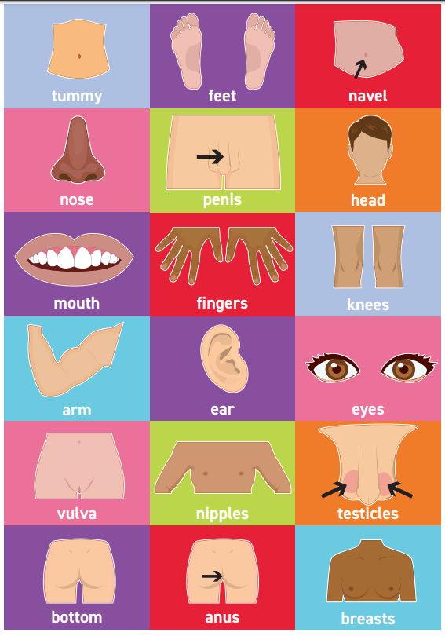
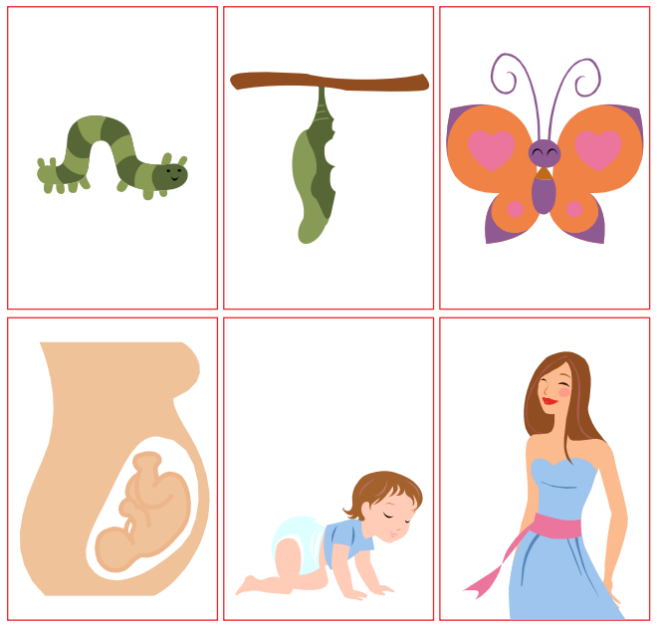
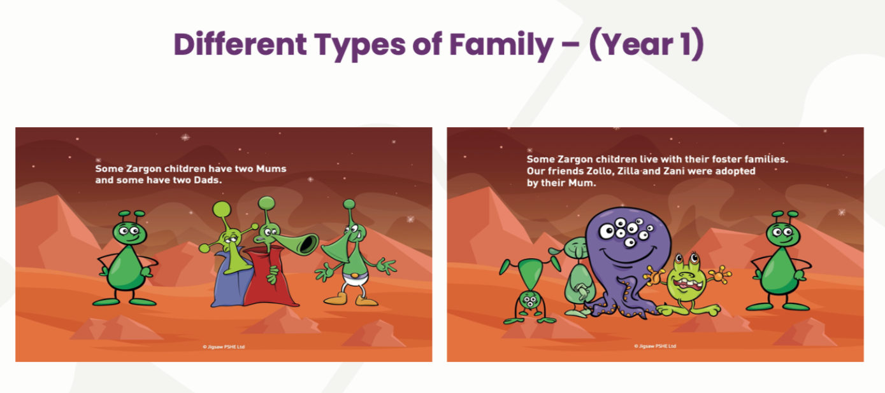
Breakdown of what RSE is taught in each year group:
Year 1
Correct naming of body parts including penis and vagina.
Life cycle of living things (babies to adults)
Ordering life cycle cards
Coping with change
Relationship and Sexuality Education with yr1 at Blaenymaes Primary - YouTube

Slide 8
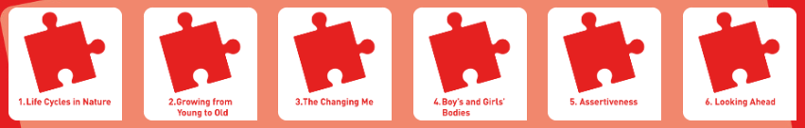
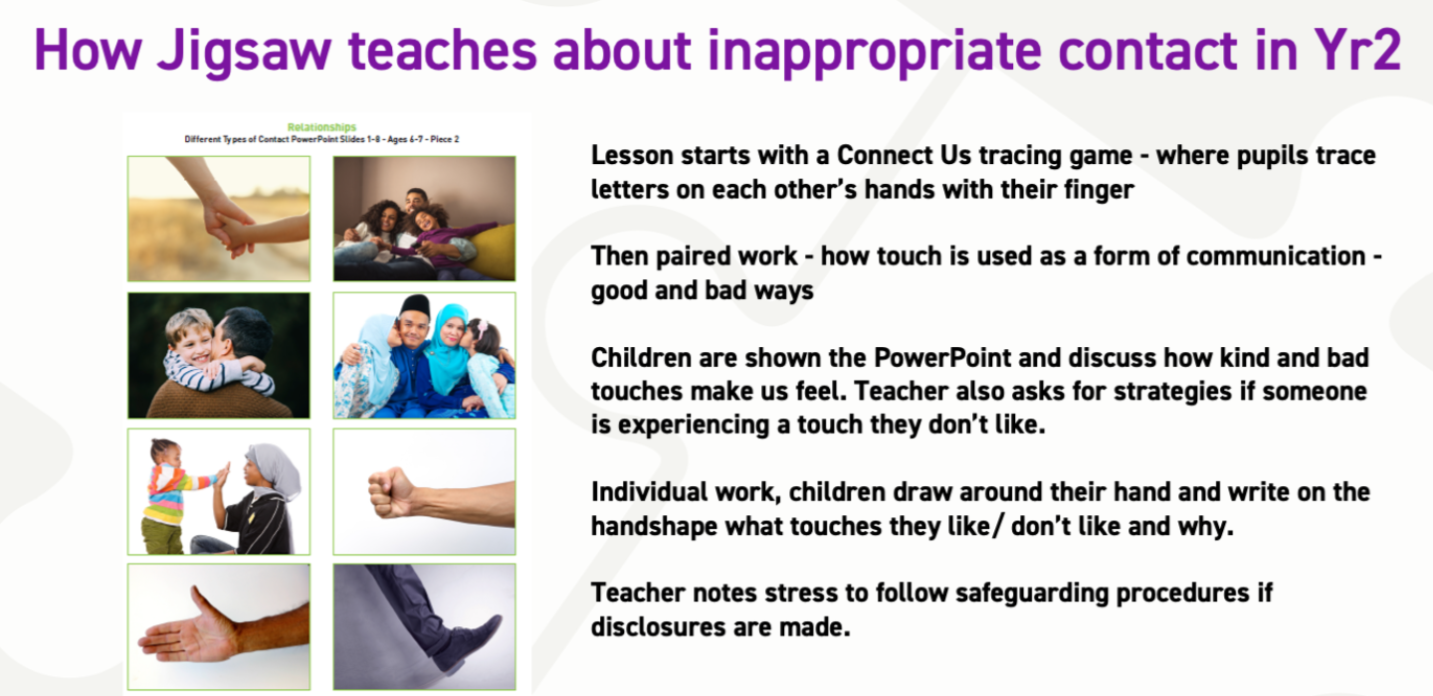
Year 2
Stages of growth
Timeline defining different stages of life (baby, toddler, teen etc)
What are ‘private’ and ‘public’ body parts
Recognising different types of ‘touch’ in context of hugs, cuddles, tickles etc.
What to do if touch makes you feel frightened or you don’t like it?

Slide 9
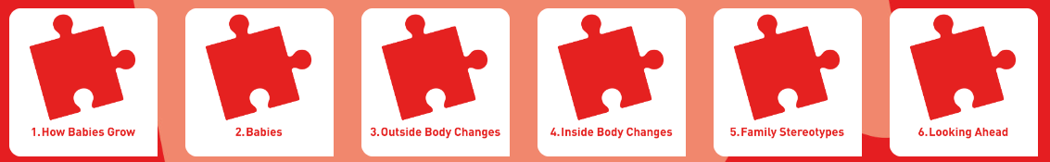
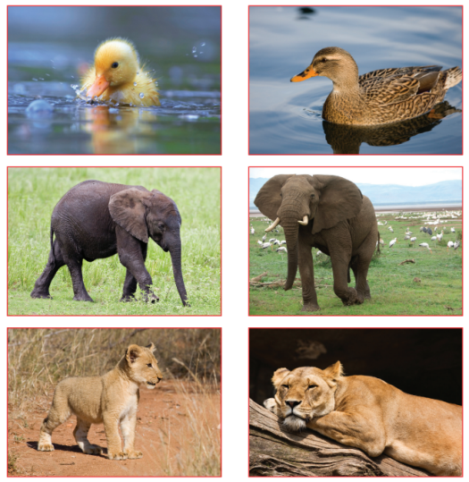
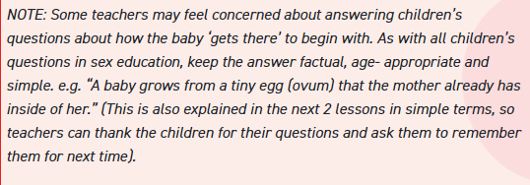
Year 3
Role of a parent when looking after a baby
How a baby’s life starts (no reference to sex) E.g. grows inside the mother get nutrients from her
Visible changes to the body due to puberty
Challenging stereotypes E.g. jobs in the house

Slide 10
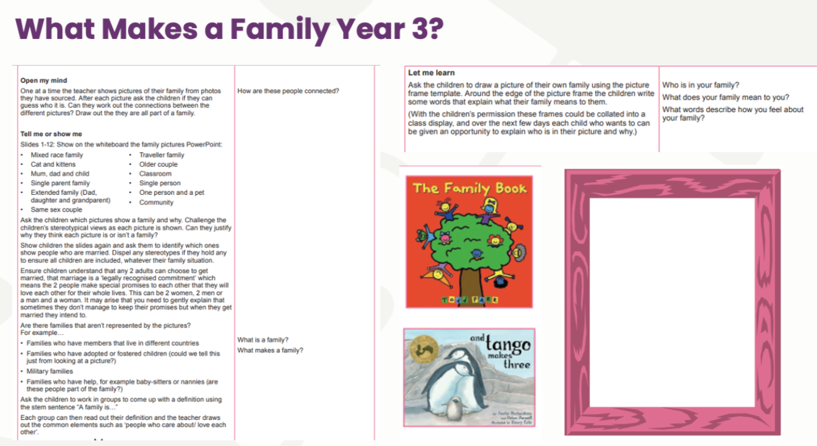

Slide 11
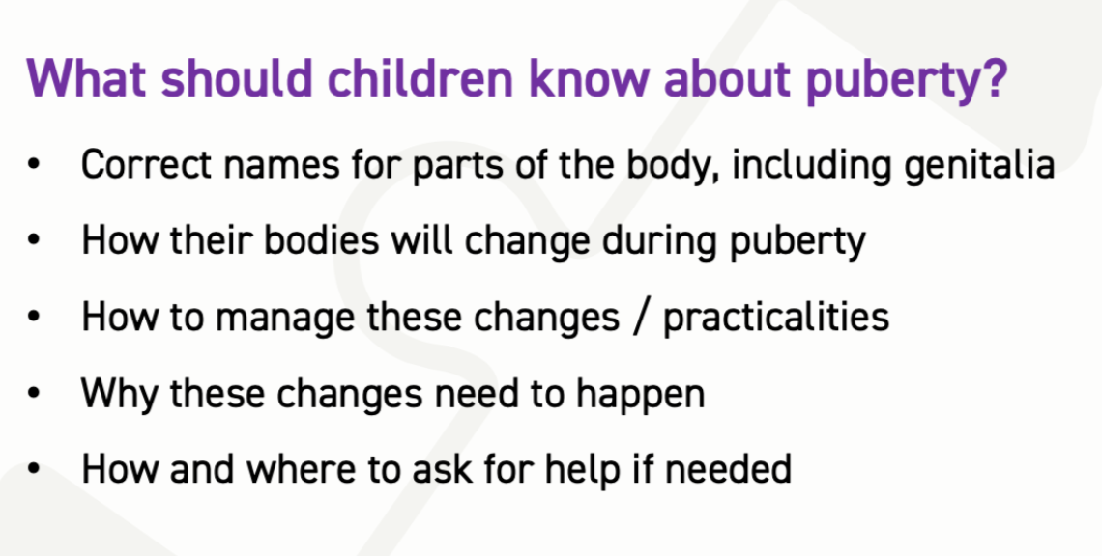
Year 4
Why children have some of their parental features
Brief explanation of how a baby is made
Changes to girls during puberty
Accepting that some changes are out of our control (seasons, puberty)
WE WILL SEPARATE BOYS AND GIRLS PUBERTY LESSONS

Slide 12
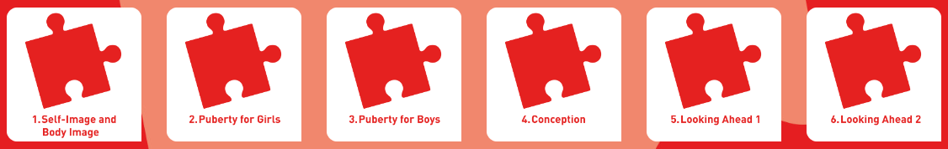
Year 5
Self image and self esteem
School health nurse will be present for both puberty lessons
Changes to girls bodies during puberty
Importance of looking after yourself physically (hygiene)
Changes to boys bodies during puberty
Conception – when a life begins. When should you have a baby?
Teenage life, what to look forward to

Slide 13
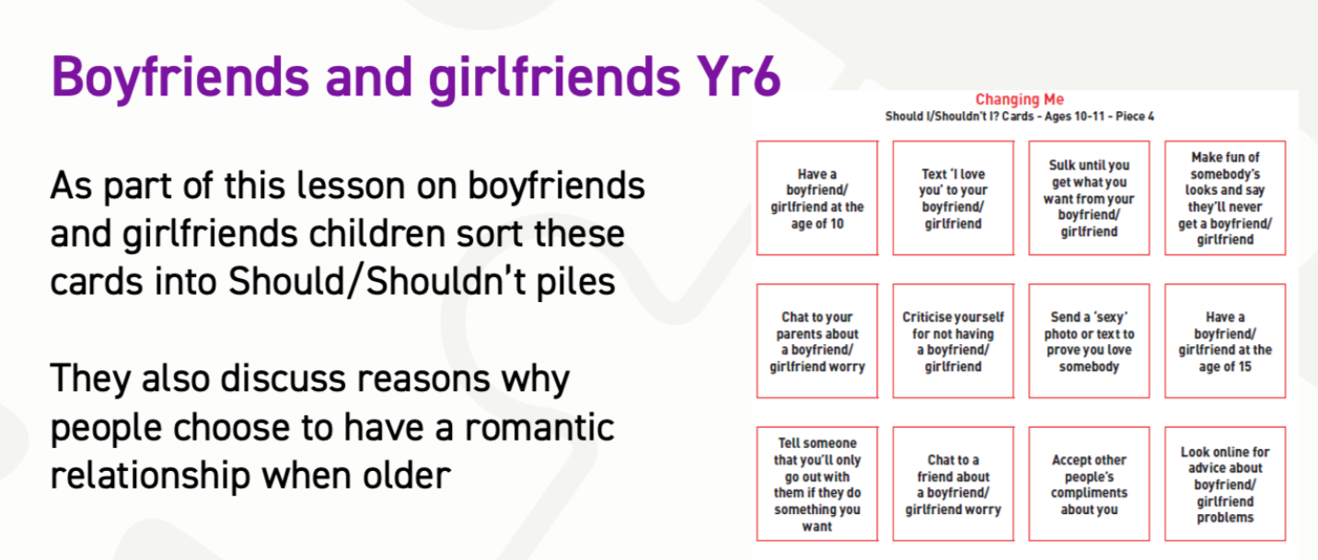
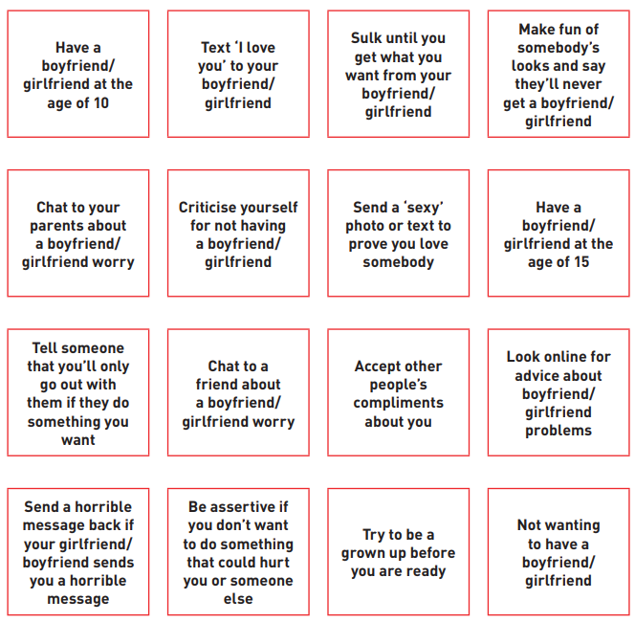
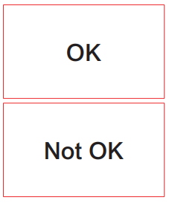
Year 6:
Self image
Recap of changes to both genders and vocabulary used
Baby development through pregnancy
Boyfriends and girlfriends – attraction
Reasons to have a boyfriend/girlfriend
Sexting
Real self and ideal self

Slide 14
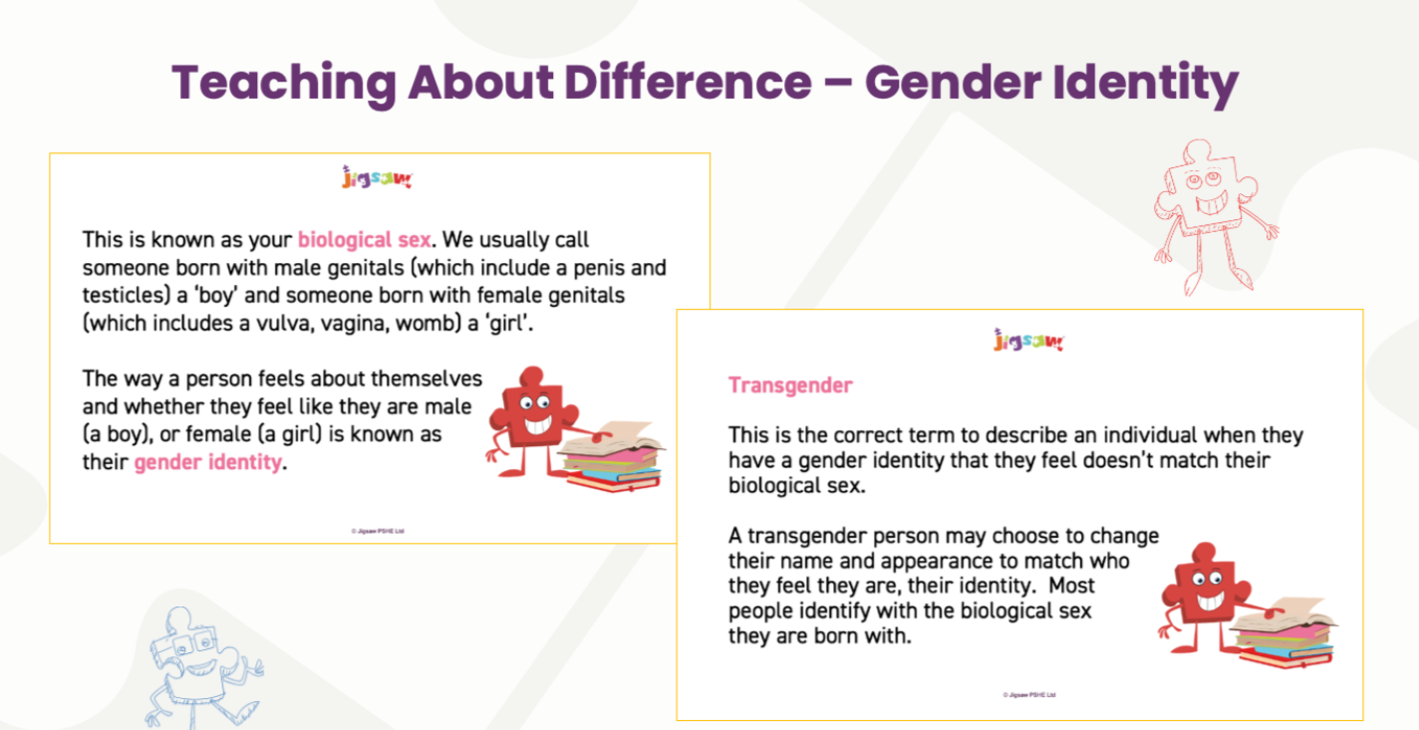

Slide 15


