Slide 1


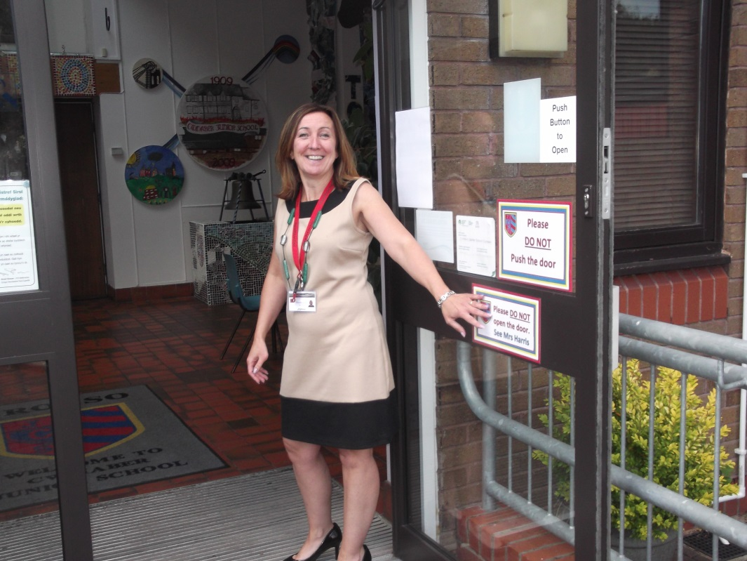
Welcome

Slide 2
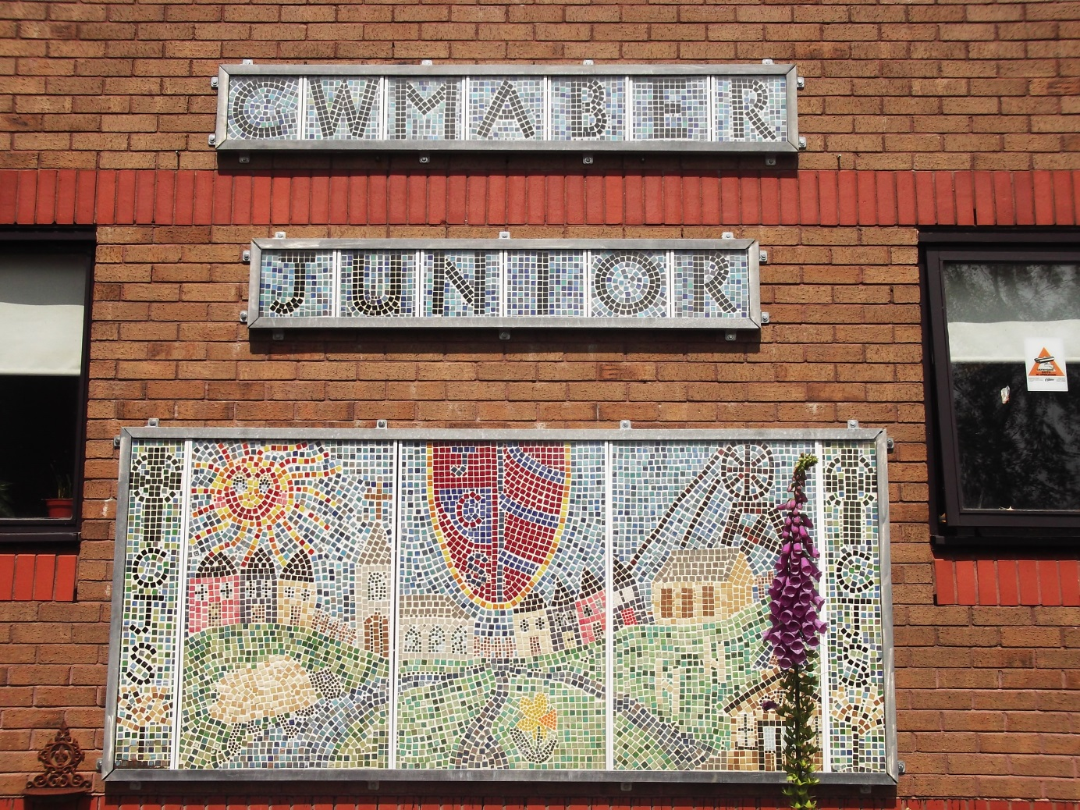
Working together to be the best we can be.

Slide 3

Welcome To Cwmaber Juniors
The aim of this powerpoint is to inform you of the changes that occur in Year 3, in order to make the transition from the Infants to the Juniors run smoothly and not cause too much anxiety for both Parent and Child!
The emphasis in Year 3 is on growing independence and responsibility both in school and when completing homework.

Slide 4


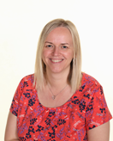

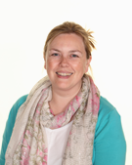

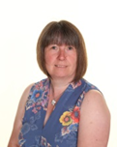






Meet THE STAFF
Miss Howells
Deputy Head
Mrs Davies
Headteacher
Mr Vaughan
Caretaker
Mrs Harris
Clerk
Miss Knight
Teacher
Mrs Dann
Teacher
Mrs Williams
Teacher
Mrs Weston, Miss McNamara, Miss Beddoe, Mrs Gilbert, Miss Newbold, Mrs Thomas
Teaching Assistants / Lunchtime Supervisors

Slide 5

School Timetable
School Starts – 8.55am
Children will be supervised from 8.45am
Assembly 10.30am – 10.45am
Morning Break – 10.45am to 11am
Lunch Time – 12.00pm – 12.55Pm
The canteen is situated in the hall.
Afternoon Break – 2.15pm to 2.30pm
School Ends - 3.30pm

Slide 6

First Day!
First Morning.
On the first morning you are welcome to come into the playground with your child from 8:45am. The bell will go at 8:55am and your child will line up in their lines. You can then watch your child go into school.
End of the Day
Please arrange with your child where you are going to wait for them outside the school gates. Try to stay in the same place. If you are not there then your child will come back into school.
Day 2
Please drop your child off at the gates from 8:45am and they will go onto the playground where they will be supervised. There isn’t any supervision before 8:45am.

Slide 7



What to bring to school
Pencil Cases
They are allowed in school and will be used in lessons in the afternoon.
Reading Books
During your child's first week they will be given a book bag, reading book and diary. These need to be brought into school daily.
Reading at home.
Please try to listen to your child read as often as you can. To begin with only listen to them read about two pages each night. Spend more time on ensuring your child understands what they have read.
PE Kit
Your child will have PE twice a week. The days will be confirmed during their first week. Please ensure they bring a PE kit to school on the required days.

Slide 8
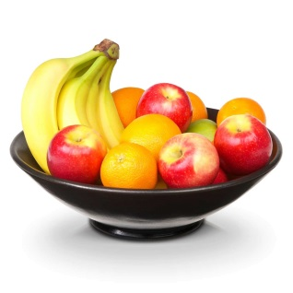
Tuck and
Lunchtime
Morning Break
During first play we have a healthy tuck shop and we sell fruit for 30p each. Children are allowed to bring in their own drink and snack but we do encourage our children to bring in healthy snacks.
Lunchtime
Children can bring a healthy packed lunch or they can have a well balanced nutritious school dinner.

Slide 9
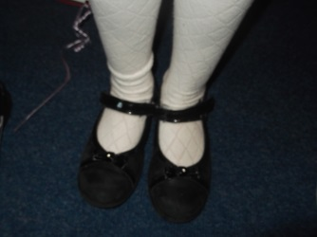
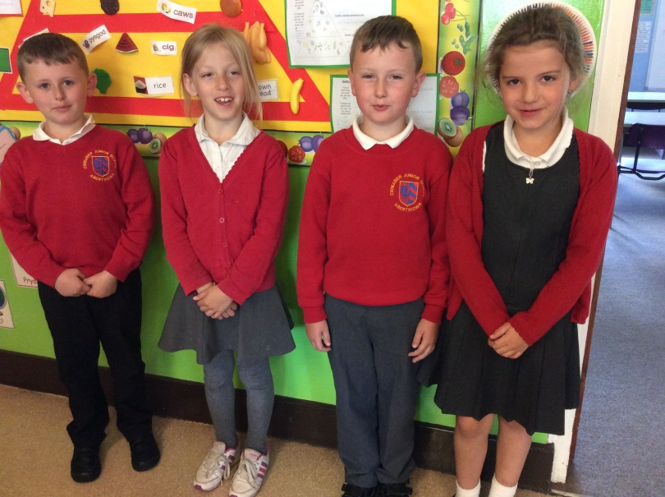
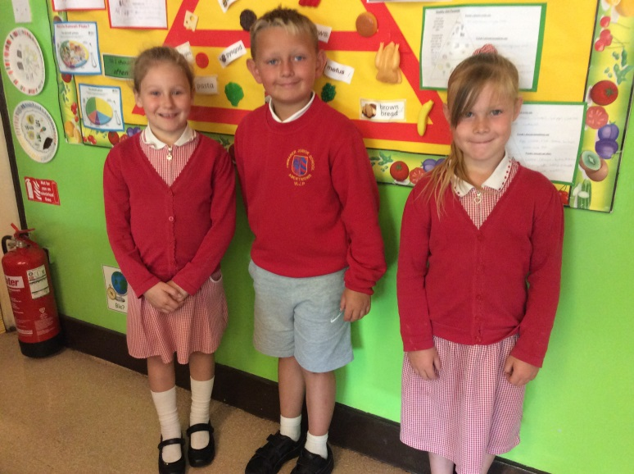
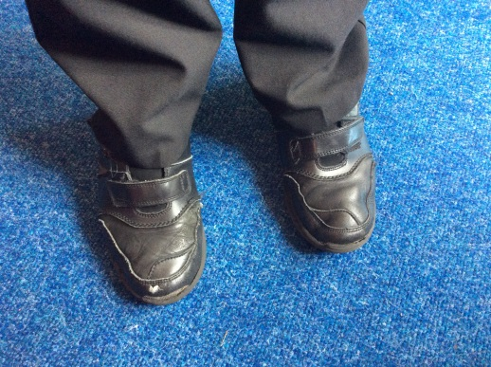
Uniform
Please ensure your child removes all jewellery before school.
Children at our school wear their uniform with pride. Please label all clothes with your child’s name!

Slide 10
Labelling
Please, please, please
Ensure that all items of clothing and equipment are adequately labelled.
Parents are justifiably annoyed when things go missing, but it is very difficult to ensure that items are returned to their rightful owner without a name.
Play it safe and label everything, from jumpers to pencil sharpeners!

Slide 11
Any Questions?
Please feel free to ask any questions by emailing cmaja@caerphilly.gov.uk or telephoning 02920 832231 and we will try to answer them as best as we can!
Thank you for reading this powerpoint. As always we value your support and we hope that we have given you a clearer picture of the expectations of Year 3.
THANK YOU!

