Slide 1
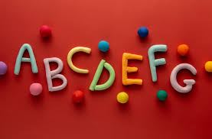

Handwriting Workshop
Cwmaber Infants
November 2024

Slide 2
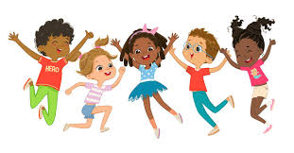
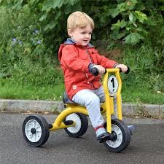
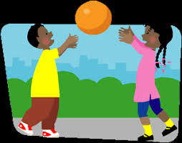
Gross Motor skills
In order to develop the strength and control in the hands and fingers, children need to develop gross motor skills which involve large movements to develop whole body coordination and strength in the arms and shoulders.
The following activities support gross motor development:
Throwing and catching a ball
Clapping
Riding bikes,
Dancing
Running, jumping, hopping

Slide 3
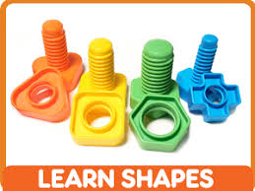
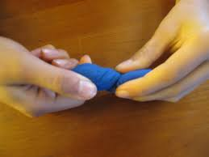
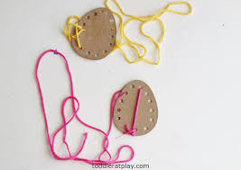
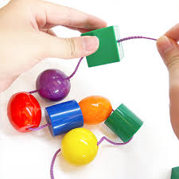
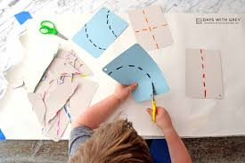
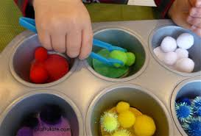
Developing Fine motor skills
It is essential that children have lots of experiences that develop their hand and finger muscles:
Threading beads
Threading string through holes
Cutting, snipping, sticking
Play dough- rolling, pinching, squeezing
Twisting screws, using tweezers to pick up small objects

Slide 4
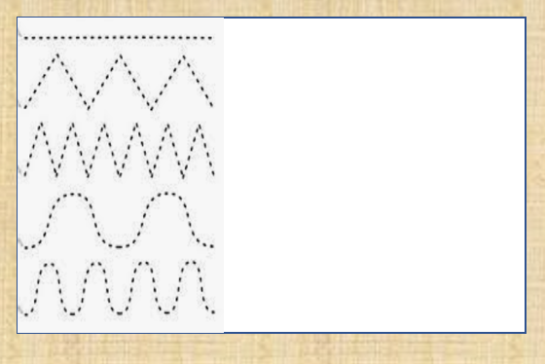
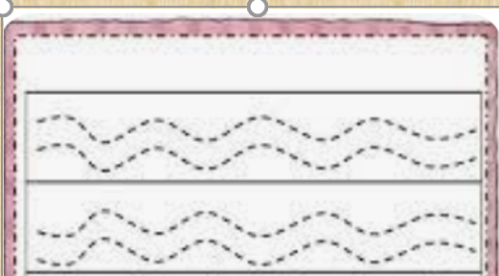
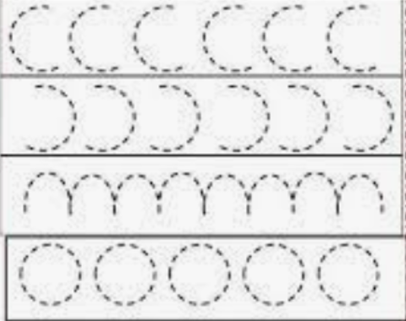
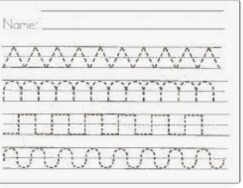
Writing Patterns
We start by making patterns in sand, shaving foam, glitter, etc.
They can then begin to follow a writing pattern using felts, pencils and crayons.
This will help them
Write from left to right.
Develop the movements and shapes needed to form letters.
Writing patterns become more complex

Slide 5
Letter Formation
Handwriting is a very complex skill which requires:
Good sitting-It is important for all children to sit properly when writing.
Correct pencil grip-Before children are ready for writing, they need to develop strength and control in their arms and shoulders, hands and fingers. Use a short pencil/crayon to encourage the child to use only their thumb, pointer and middle finger . A gripper or a triangular pencil can support children who are struggling to develop a good grip.
Time to master each skill required and time to consolidate their learning.

Slide 6
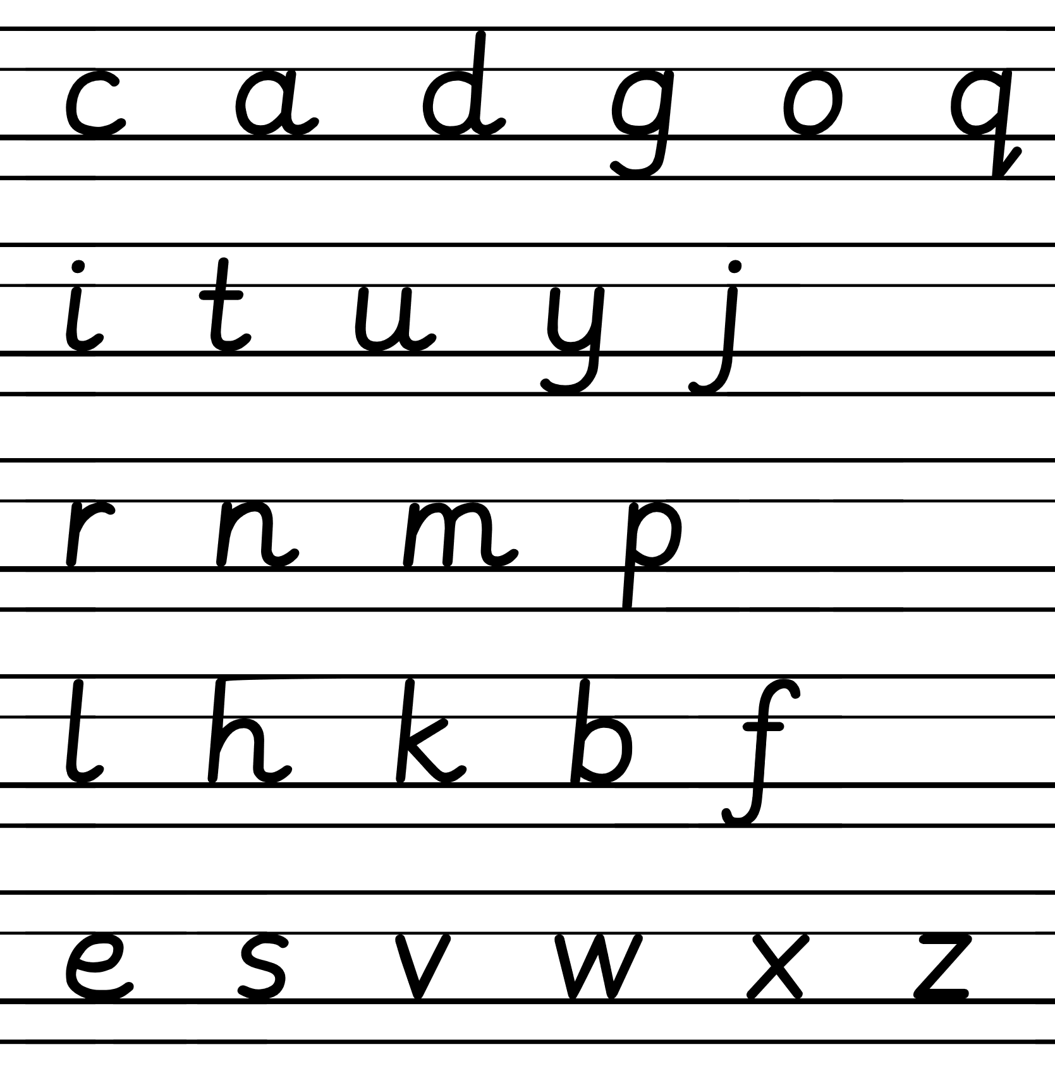
Letter Families
We teach the letters in families according to the way they are formed.
Children will have lots of practise at forming letters in sand, glitter, shaving foam, before using pencils, pens and crayons
Once the correct formation has been learned:
Make sure the child:
Always has a line to write on (once they know the formation)
Starts in the correct position- we say “In the middle” or “high in the sky”.
Sits the letter on the line.
Remembers that some letters go below the line ( “under the ground”).
Tries to keep the letters the same size (even though some might be taller).

Slide 7
Example of letter formation
Please note that we do not teach the k with a loop (as shown in the link)

