Slide 1





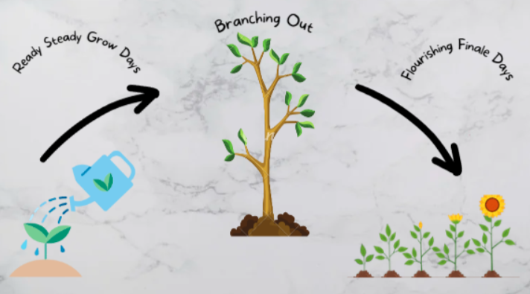








Humanities at Cwmaber
Aims of Humanities at Cwmaber:
Personal and effective to our pupils
Experiences and gain knowledge allowing them to become ethically informed citizens
Importance of the local area and wider world
Creating links with other AoLEs creating a holistic approach to learning
Exploring differences and similarities between themselves and others
. Creates pupils who are eager to explore the world in respectful ways
Develop a strong sense of cynefin and explore what cynefin means for each pupil
Welsh and MFL:
Ble wyt ti’n byw? Dw i’n byw yn ….
Criw Cymraeg
St David’s Day celebrations
Incidental Welsh used in classroom and around the school
Spanish and French learnt as MFL language
Curriculum Design
4 Purposes
Ambitious Capable Learners | I can use my digital skills to find out information I can research
Healthy Confident Individuals | My friends and I trust and respect each other. I can say what is important to me
Enterprising Creative Contributors | I can take part in new activities and opportunities
Ethical Informed Citizens | I get involved in things in the news I know about my right and give my views I know my actions can affect others I learn about my community and the world, now and in the past I respect and enjoy the way all people are different I want to do my bit to save the planet
Our Values
Curriculum Cycle
Principles of Progression:
Increasing breadth and depth of knowledge in specific areas
Deepening understanding
Refinement and growing sophistication in the use and application of skills across the curriculum
Making connections and transferring learning and knowledge
Increasing effectiveness as a learner
History focus: Remember Remember, Conflict, Around The World, Terrific Techno
Geography Focus: Changes, Our Watery World, Blue Planet
Business focus: Money Makes The World Go Round
RVE Discreet focus: Sikhism (Diwali), Islam (Eid), Judaism (Hanukah), Christianity (Christmas and Easter)
.
RVE Integrated focus: Personalised RVE curriculum linked to Identity and Belonging
Outdoor Learning and Community Links:
Visits to local church
Club 707 afternoons and assemblies
Community fundraising for Food Bank
Visits to Senghenydd memorial
Focus in cynefin
Community walks
The School Ethos links:
UNCRC Rights
Eco Week
School Pupil Voice Groups
Pupil driven curriculum and classroom areas
DCF:
Seesaw
Pupil researching and saving their own work
Google maps to explore local and national areas

