Slide 1


What are Children’s rights?

Slide 2
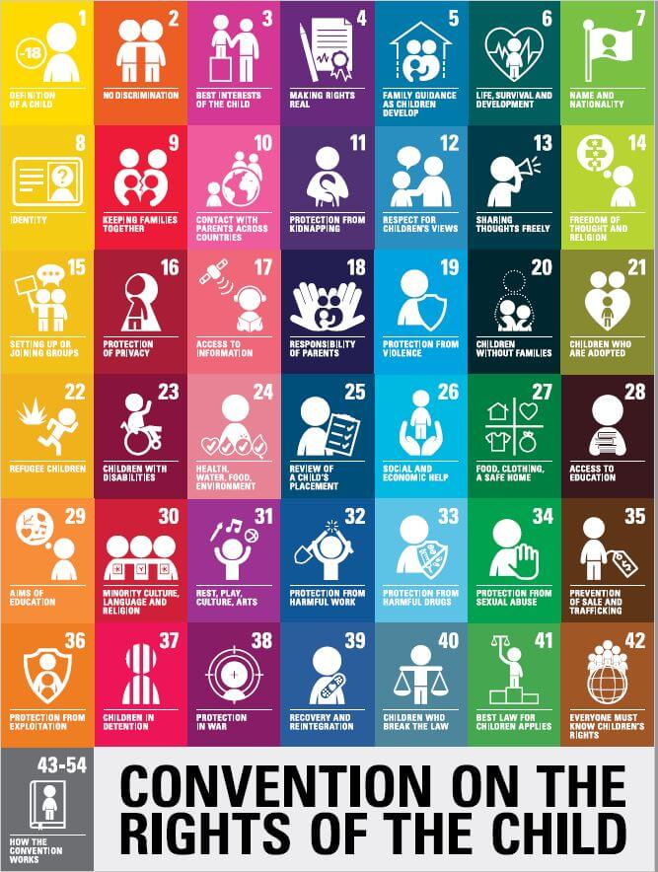
Un convention of the Rights of the child
The Convention has 54 articles that cover all aspects of a child’s life and set out the civil, political, economic, social and cultural rights that all children everywhere are entitled to. It also explains how adults and governments must work together to make sure all children can enjoy all their rights.
Every child has rights “without discrimination of any kind, irrespective of the child’s or his or her parent’s or legal guardian’s race, colour, sex, language, religion, political or other opinion, national, ethnic or social origin, property, disability, birth or other status” (Article 2).

Slide 3
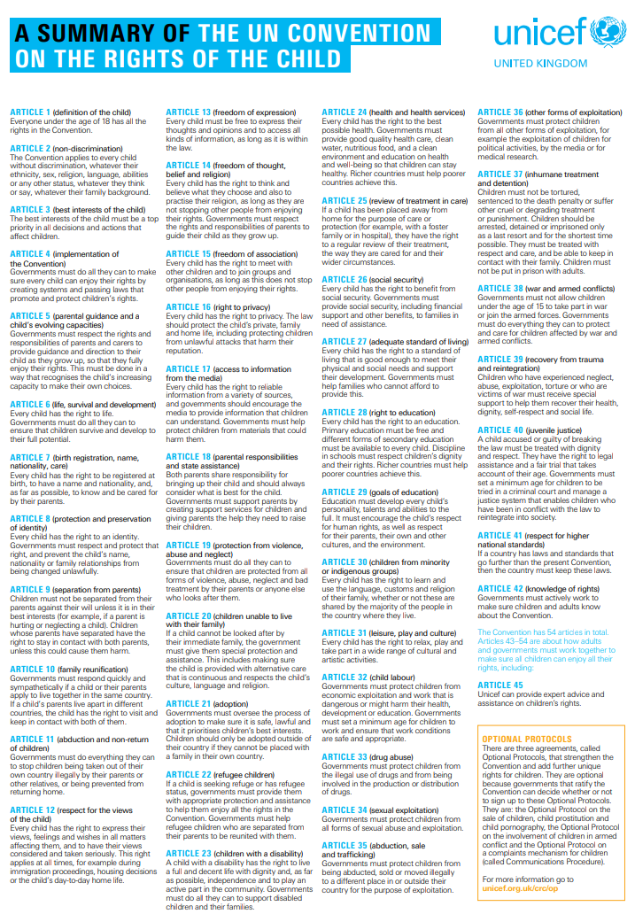
Main rights covered in school
Right to a name
Right to a house
Right to a religion
Right to speak
Right to relax and play
Right to an education
Right to speak your own language
Right to access information
Right to grow up and reach your full potential
Right to meet friends and join groups
Right to be kept safe

Slide 4
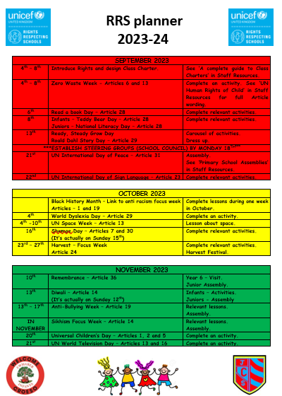
Our Rights Journey so Far
Cwmaber Infants achieved the Silver Rights Respecting Schools award in 2019. Since then, we have continued to work towards Gold by further developing our knowledge of rights and teaching pupils through a rights based approach.
Cwmaber Junior School achieved Silver in 2021 and have been continuing to work hard on their journey through the new Cwmaber Collaborative Curriculum.
We are hoping to achieve our joint collaborative Gold award Summer 2024.
We cover themed days throughout the Year to make sure we are incorporating Children’s rights into our daily practise. Our pupil voice groups are instrumental in making sure that their opinions count and we listen to their views by implementing ideas they have.

Slide 5
What does a Rights respecting school look like?
There are four key areas of impact for children at a Rights Respecting school; wellbeing, participation, relationships and self-esteem.
The difference that a Rights Respecting School makes goes beyond the school gates, making a positive impact on the whole community.
Children are healthier and happier
Children feel safe
Children have better relationships
Children become active and involved in school life and the wider world
Through our Rights Respecting schools journey we work hard to ensure we create environments where children are respected, their talents are nurtured and they are able to thrive.
By embedding these values in daily school life, we can give children the best chance to lead happy, healthy lives and to be responsible, active citizens.

Slide 6
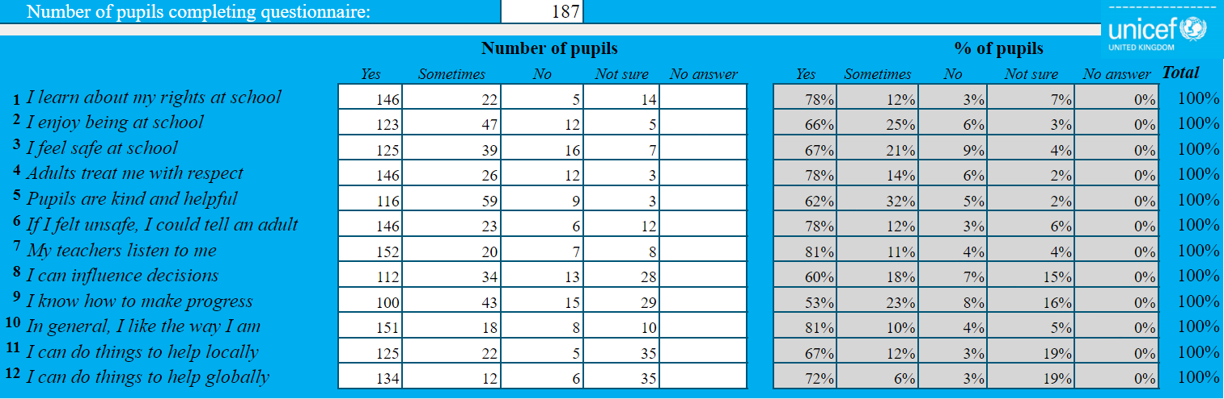
What do our pupils think?

Slide 7
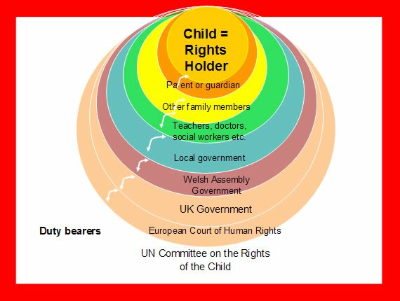
Duty bearers
Adults will understand their role in ensuring that children and young people are able to experience all of their rights.
Adults will support the empowerment of children and young people through supporting them to become active global citizens and promote children’s rights.
Children and young people have opportunities built into their learning to take action to support the rights of others.

Slide 8
Plans for the Summer Term
Make our pupils more aware of Global issues.

Slide 9
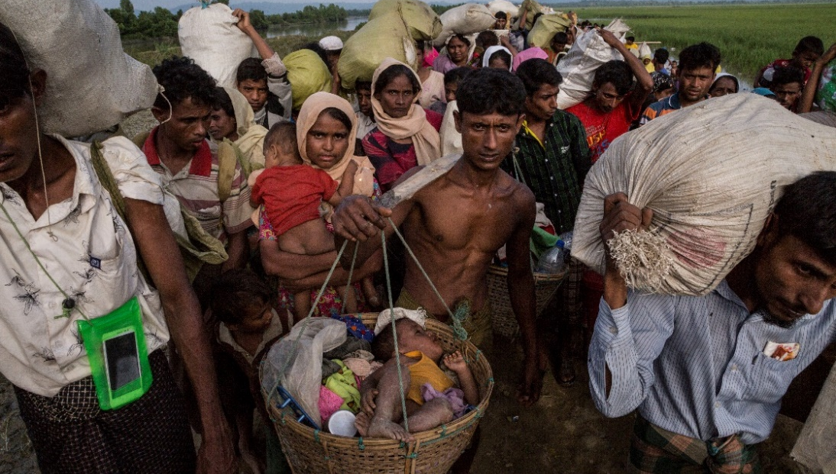
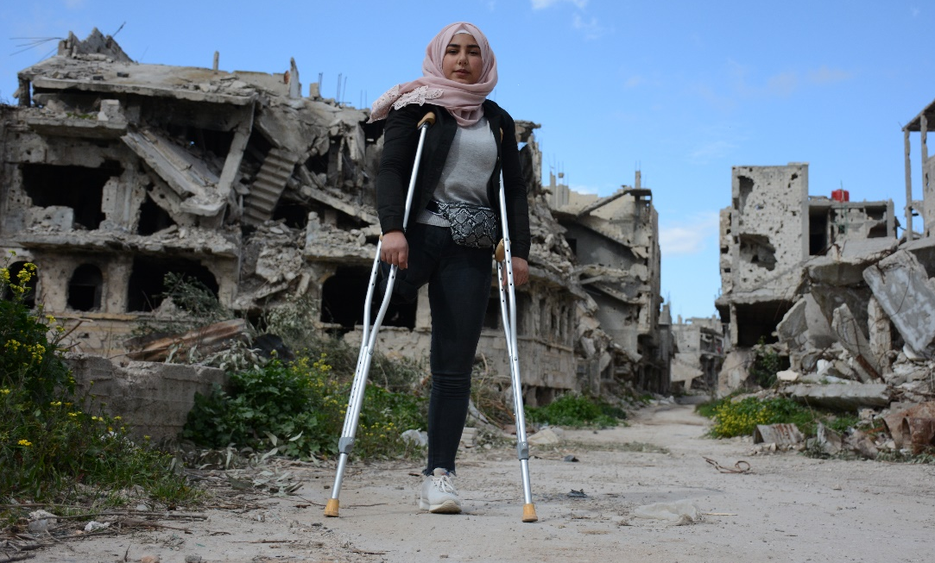
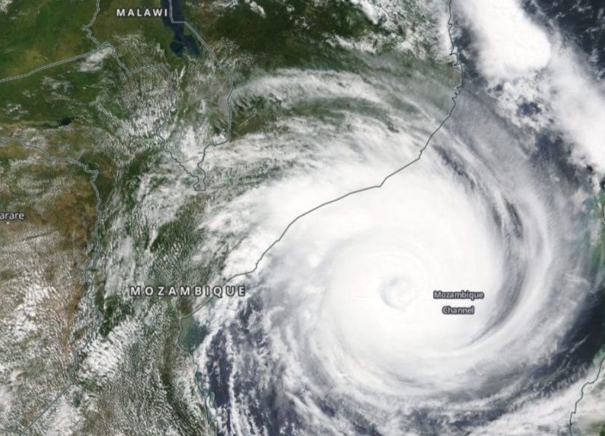

FUNDRAISE IN EMERGENCIES
Children experience emergencies all over the world for lots of different reasons. They can be due to conflicts, natural hazards such as cyclones and earthquakes, climate events such as droughts and floods, or by the outbreak of diseases.

Slide 10
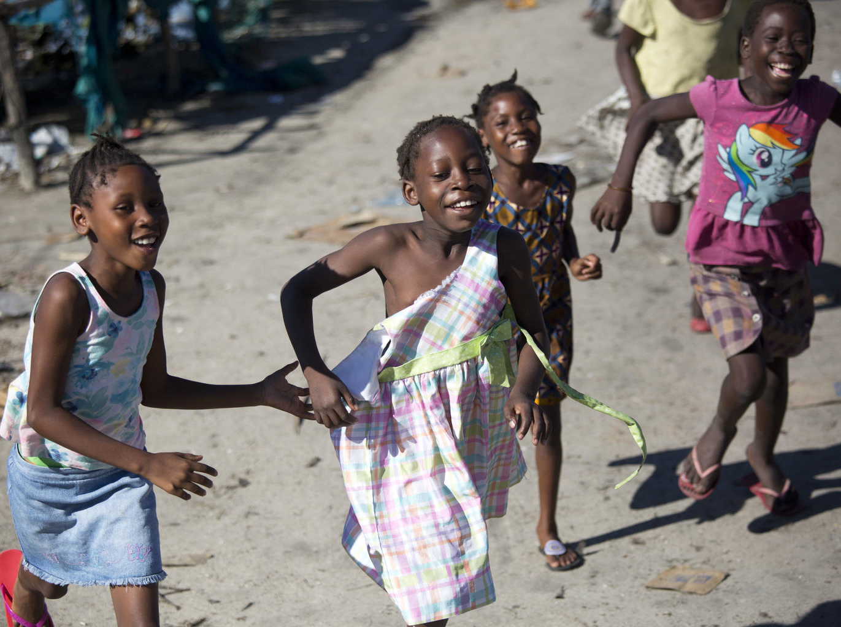
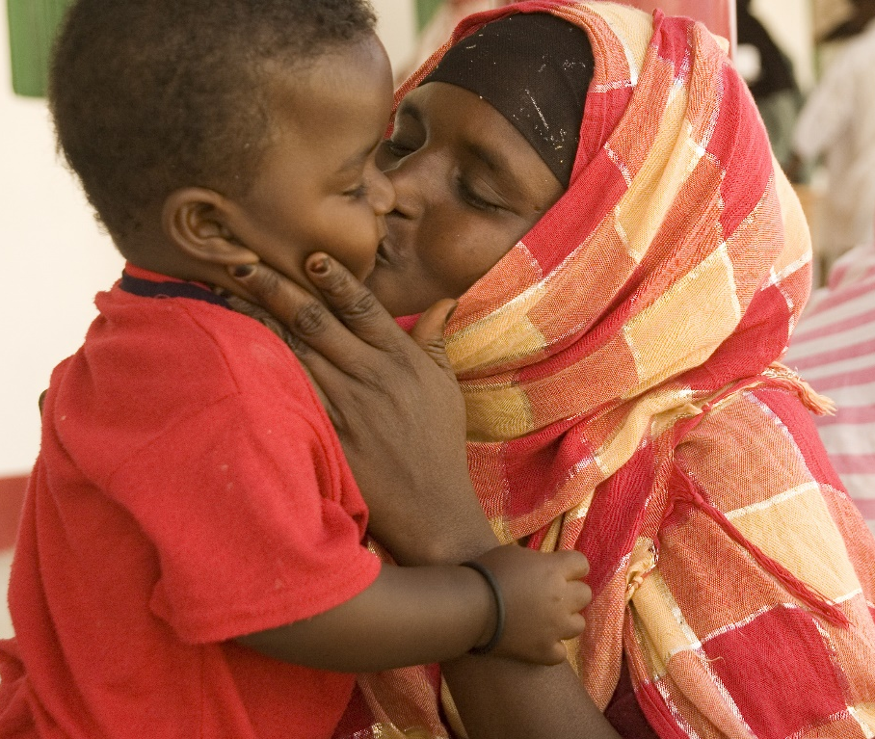
We need your help to educate our pupils.
59 million children across 69 countries need help.
UNICEF and other humanitarian organisations are working hard to reach every one of them, and to make sure that they are accessing their basic rights, including to be cared for, protected, and have access to food, shelter, nutrition, healthcare and protection, as well as clean water and sanitation. We want to educate our pupils on why some children aren’t able to access their rights so every class will be completing a sponsored event to raise money for UNICEF to ensure the rights of the children are protected.
Thank you for your continued support and cooperation.
We hope you enjoy working with your child on some
rights based activities.

